Slide 1




Essentially No Barriers in Neural Network Energy Landscape
Felix Draxler¹², Kambis Veschgini², Manfred Salmhofer², Fred A. Hamprecht¹
1
2
Notes:
Master Thesis under the supervision of
Kambis Veschgini and Manfred Salmhofer @ Institute for Theoretical Physics
Fred Hamprecht @ Heidelberg Collaboratory for Image Processing
both at Heidelberg University, Germany. (30s)

Slide 2
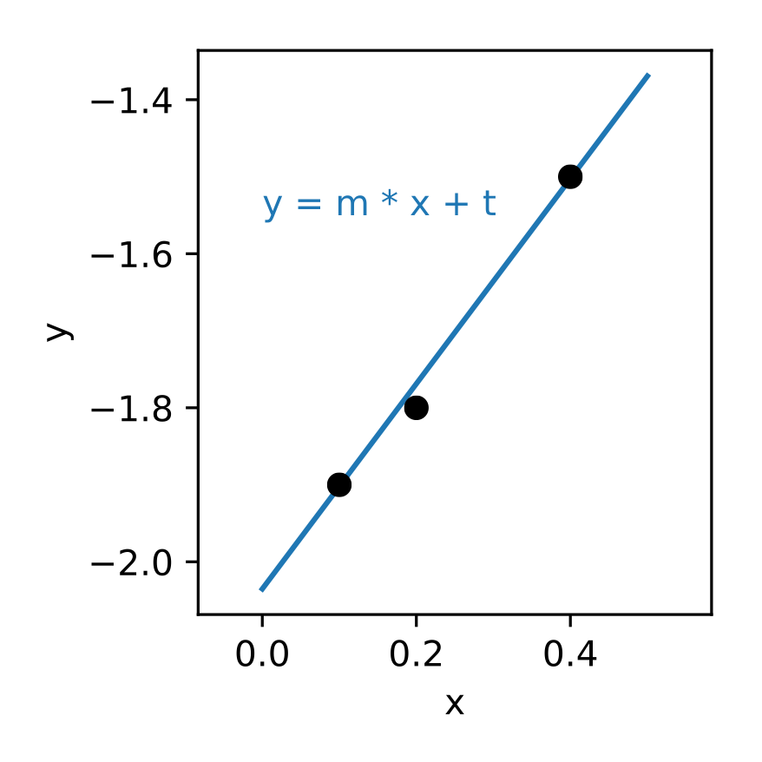
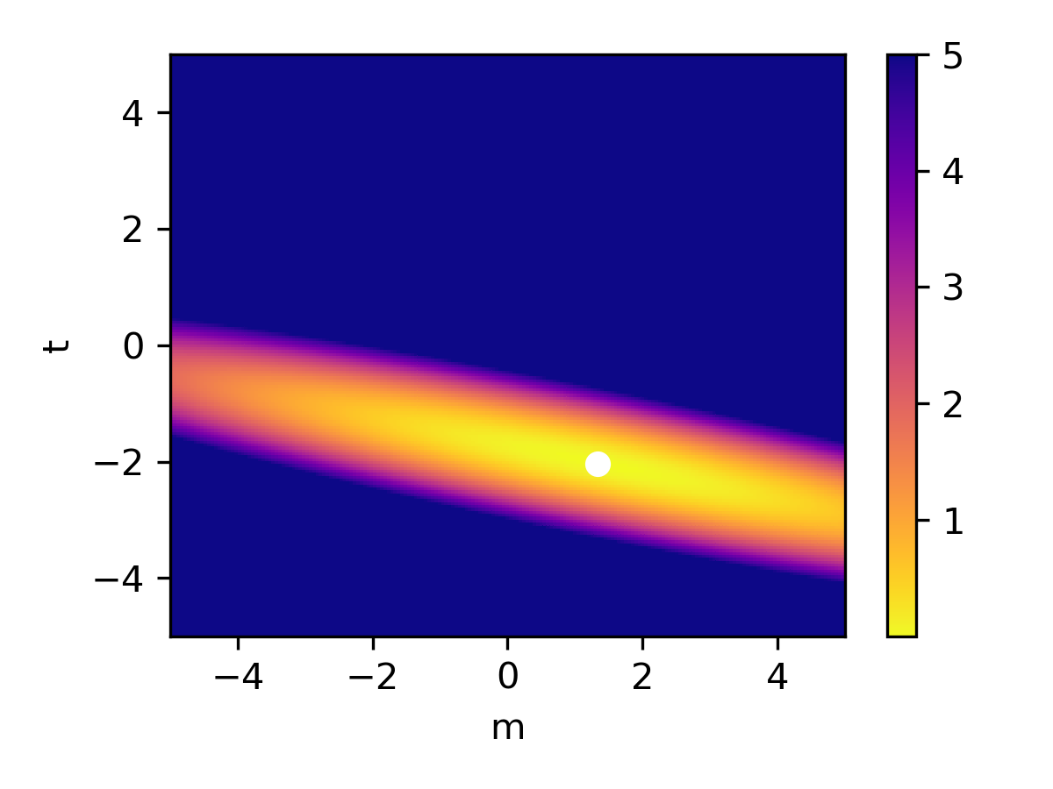
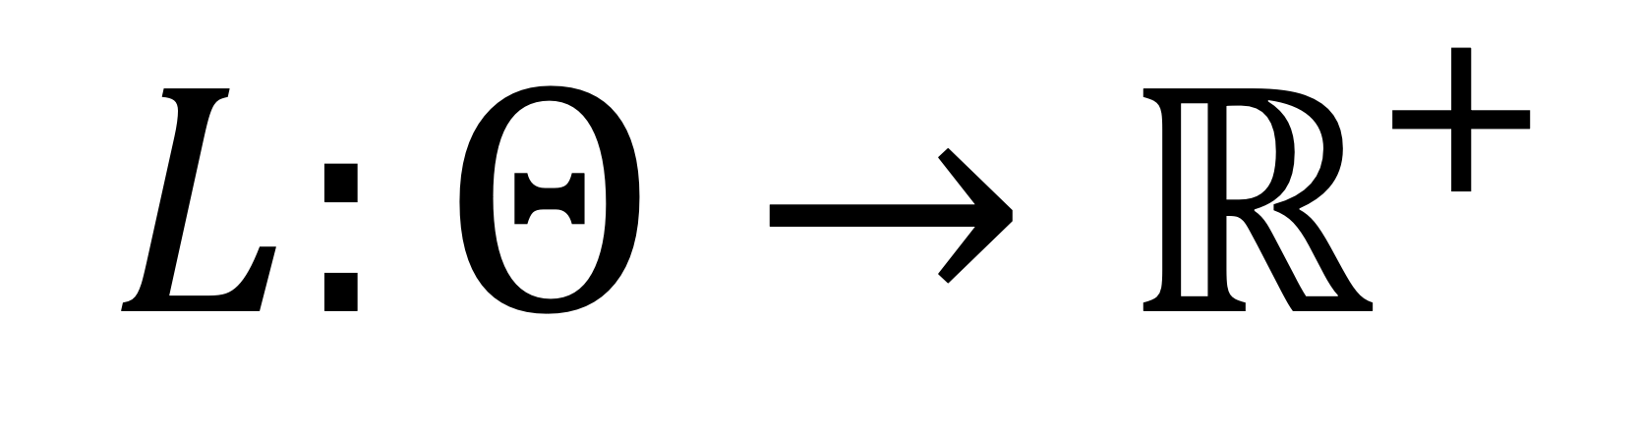

Neural Network Energy Landscape
Loss
$$L:Θ→ℝ^{+}$$
Architecture (CNN, …)
Data (CIFAR, …)
Network parameters
$$L(m,t)$$
Notes:
ML to fit training data:
Loss depends on architecture, cost function, data, … and network parameters
Energy: Fix everything except for parameters
Training: Find parameters that minimise energy/loss

Slide 3
Neural Network Energy Landscape
Loss
$$L:Θ→ℝ^{+}$$
non-convex
high-dimensional
no bad local minima
good generalisation
Notes:
Loss: function of network parameters -> fix architecture and data
Bad optimisation properties: non-convex and high-dimensional
Yet: easy to train and minimisers have good generalisation
No analytical results explain this.
Today: Exciting news about the structure of the loss surface.

Slide 4
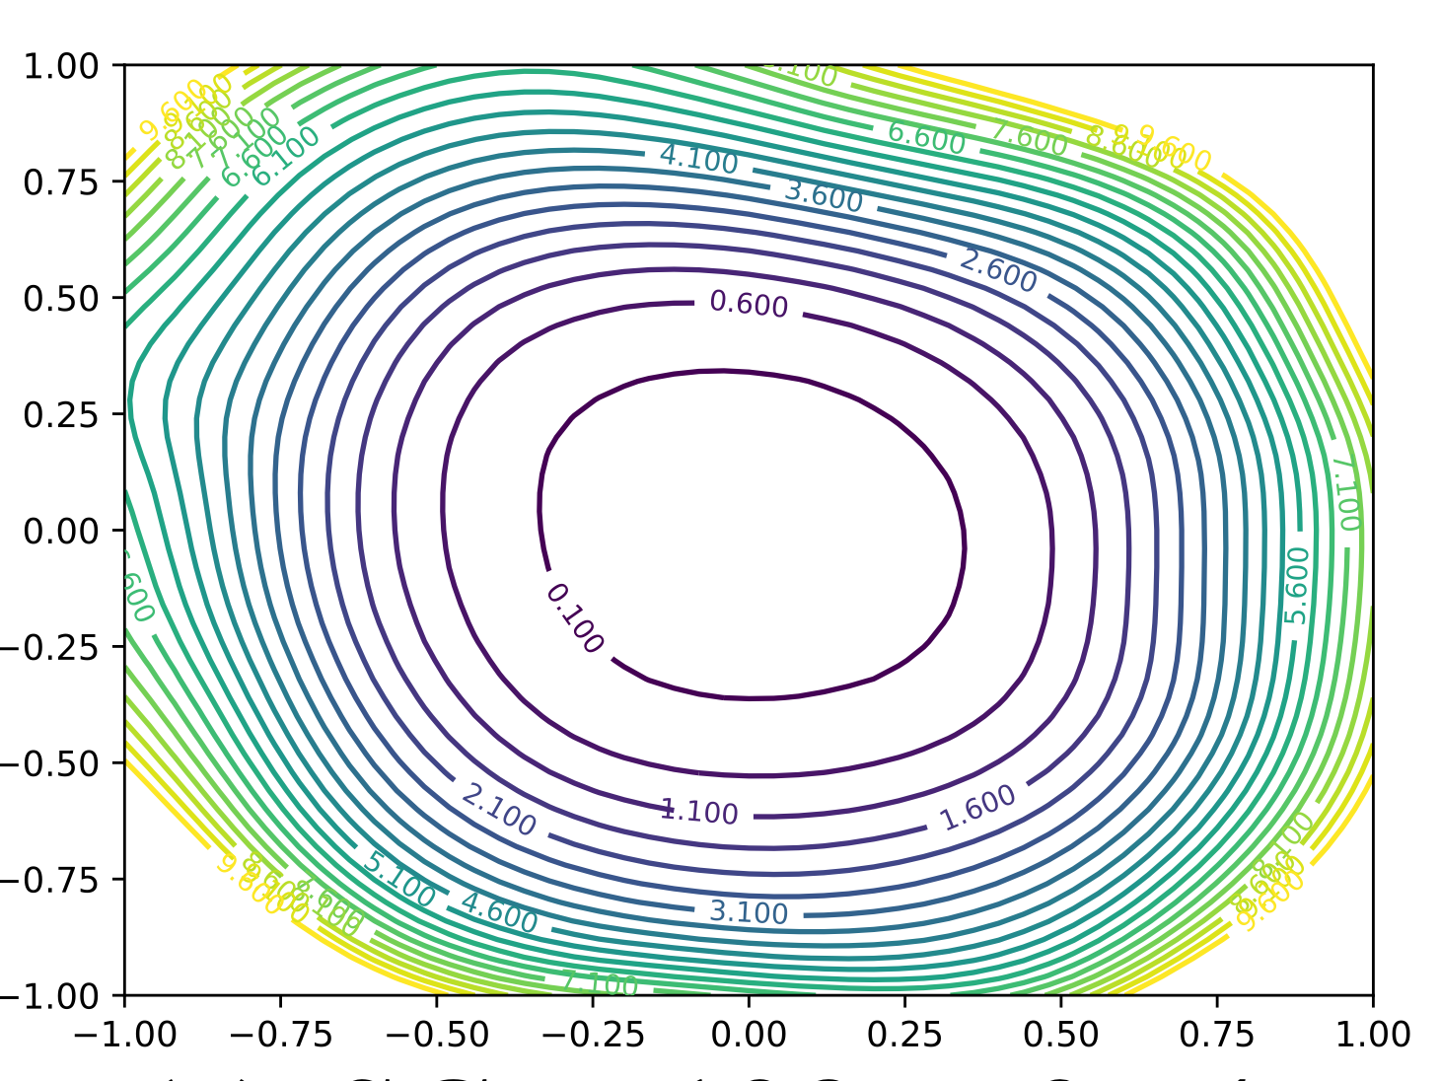
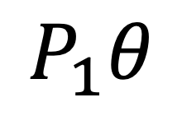
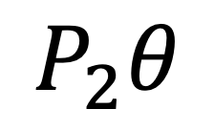
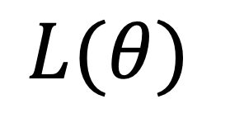
Minima
Minima at bottom of valleys
Wide minima generalise better (Keskar et al., ICRL 2017)
Training choices shape the valley (Li et al., 2017)
Method: Sample loss around minima.
$$L(θ)$$
$$P_{1}θ$$
Li et al., 2017
$$P_{2}θ$$
Notes:
Knowledge on structure of minima:
Bottom of locally convex valleys
A good minimum lies in a wide valley (neglecting symmetries)
Training parameters shape the surroundings of minima.
Method: Shoot a line or span a plane in random directions from minima and sample the loss along the line or on that plane.

Slide 5
Paths through Landscape
Loss
Loss
Loss
Loss
Path
Path
Path
Path
Goodfellow et al., ICRL 2015
Keskar et al., ICRL 2017
Freeman & Bruna, ICRL 2017
Sagun et al., ICRL 2018
Notes:
Rest of the Loss Surface: No full sampling possible => Sample along paths!
Goodfellow & …: Regular structure: No obstacles are in the way from initial point to minima.
Keskar & …: Train two distinct minima from different initialisations => Barriers in between.
Freeman & Bruna: Curved path enables lower barriers. Only few architectures.
Sagun et al: Large batch minimum, continue with small batch optimisation. Linear connection => no barrier.

Slide 6
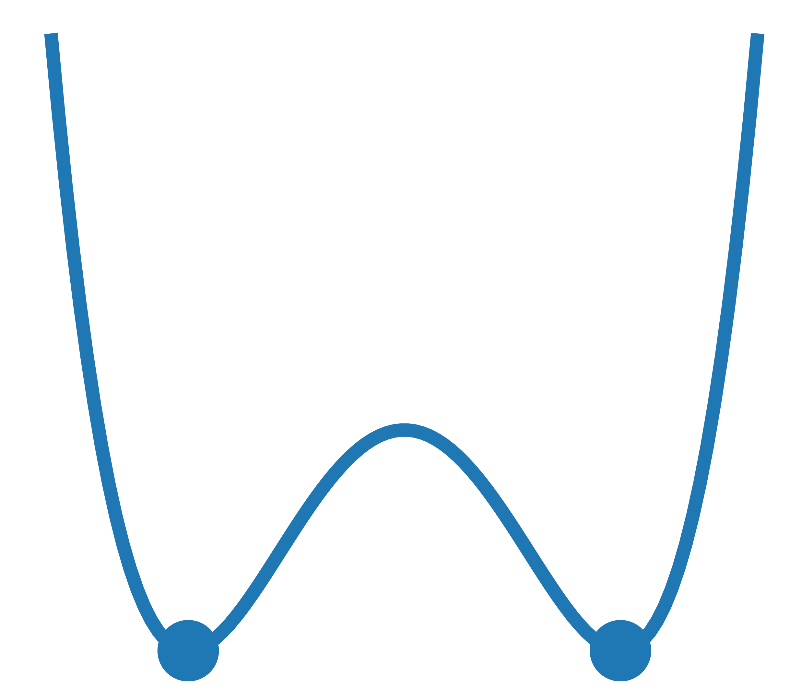
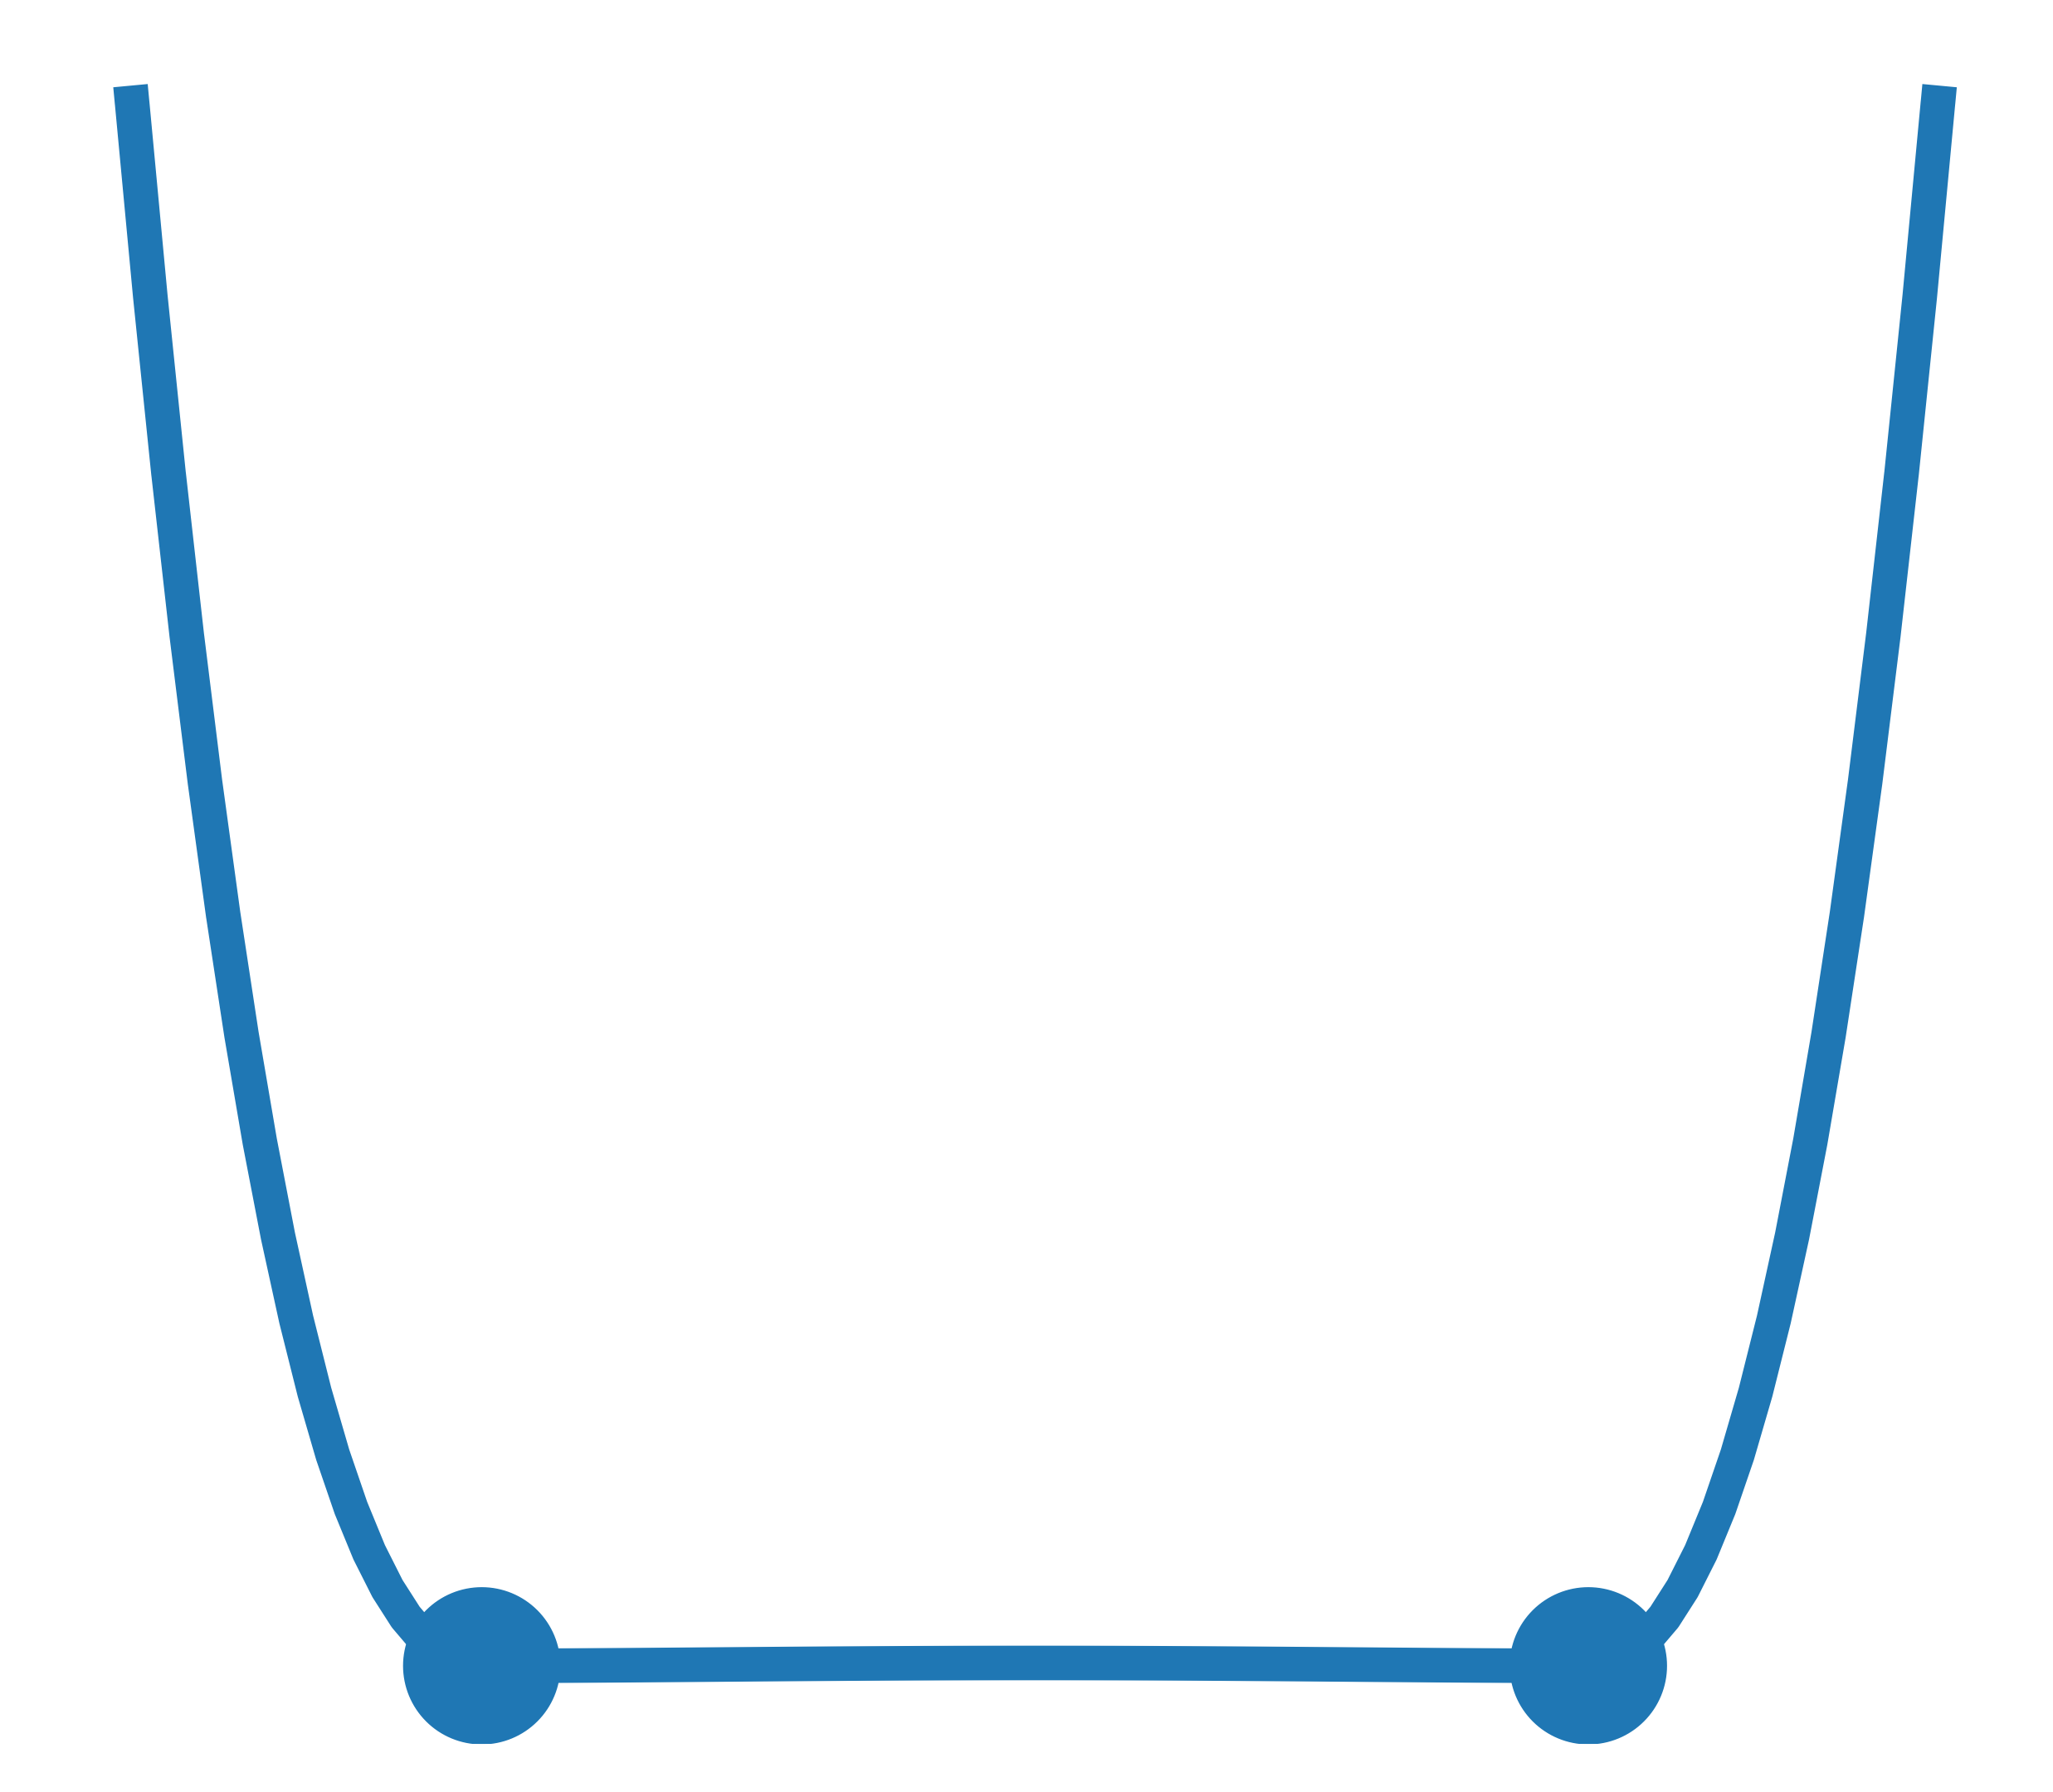
Our Contribution
Connected Minima
Mode Connectivity
Isolated Minima
Loss
Path
Path
➡ No Bad Minima
Notes:
Geometrically flexible connection procedure following local geometry
Find: Minima not isolated, but connected (also called Mode Connectivity)
Non-trivial: Minima are not related, but generated independently.
Class of connected minima cannot be bad!

Slide 7
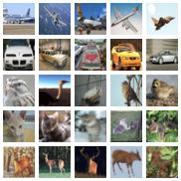
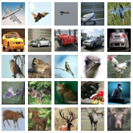
Minima are not equal
Overlap of misclassified instances < 50%
CIFAR10 dataset
Misclassified
by Minimum 1
Misclassified
by Minimum 2
Notes:
Can test: We have independently trained minima!
Even though the loss is equal, the output is entirely different.
Circles are the misclassified images of each minimum.
The overlap for each pair of minima is less than 50% for all datasets!

Slide 8
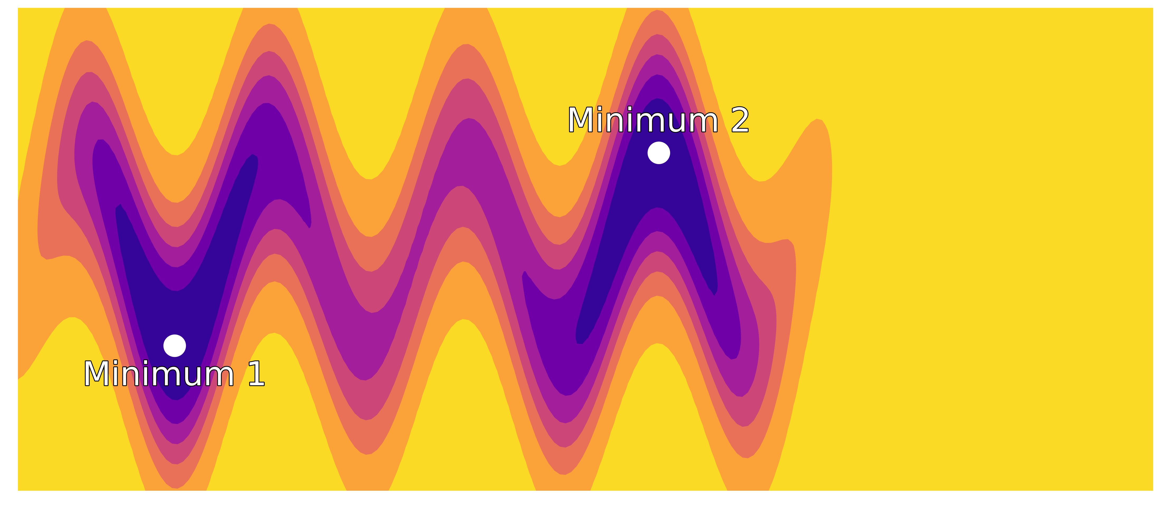
Method
Task:
Find path with the lowest highest point.
Notes:
Contour plot of toy energy/loss function with nontrivial geometry
Goal: Numerically find the barrier between minima.

Slide 9
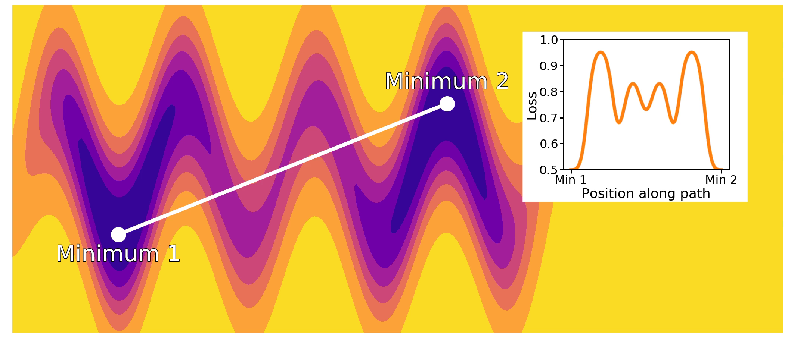
Method
Barrier
Notes:
Start with linear path and bend by local gradient. <Show video>
Stop when no more gradient perpendicular to path.
Then identify barrier.
Final path need not be globally optimal, only locally.
Numerically, no representation for continuous path.

Slide 10
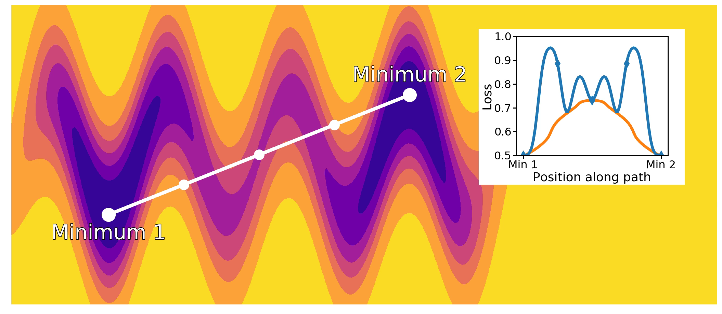
Method
Notes:
Represent path by linear pieces.
Call the points where the pieces meet „pivots“.
Here a point in 2D, later a full parameter vector of a neural network.
This representation can follow curvy paths, if we have enough pivots. <Show video>
Here, the number of pivots is too small.
We never now how many pivots are needed and gradient computations are expensive:
Insert new pivots as needed (where loss rises to high between pivots).

Slide 11
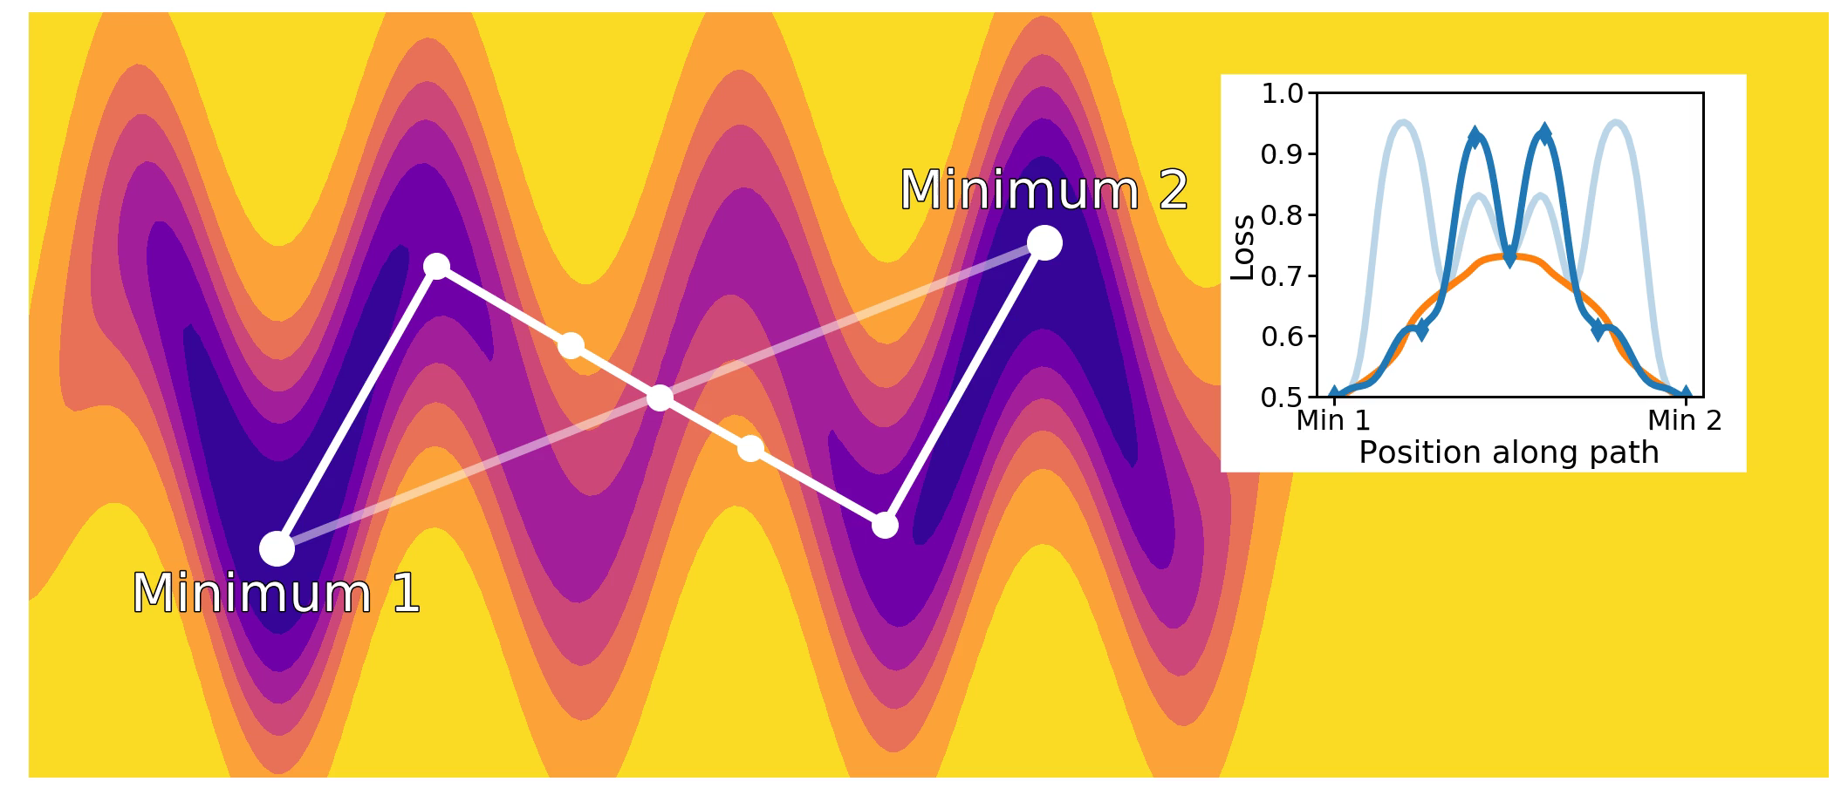
Method
Barrier
Notes:
<Show video>
Repeat this procedure of {optimisation + insertion} until convergence.
This is then called Automated Nudged Elastic Band (AutoNEB).
We closely converge to the continuous solution.

Slide 12
Method
Initialise linear path between independent minima
Iterate:
Move pivots by loss gradient
Insert pivots where needed
Read off barrier loss
NEB: Nudged Elastic Band (Jónsson et al., 1998) AutoNEB: Automated Nudged Elastic Band (Kolsbjerg et al., 2016)
Notes:
Recap:
Initialise
Iterate descent and insertion
Read off final barrier
Well established: NEB and AutoNEB
Tested on many high-dimensional problems

Slide 13
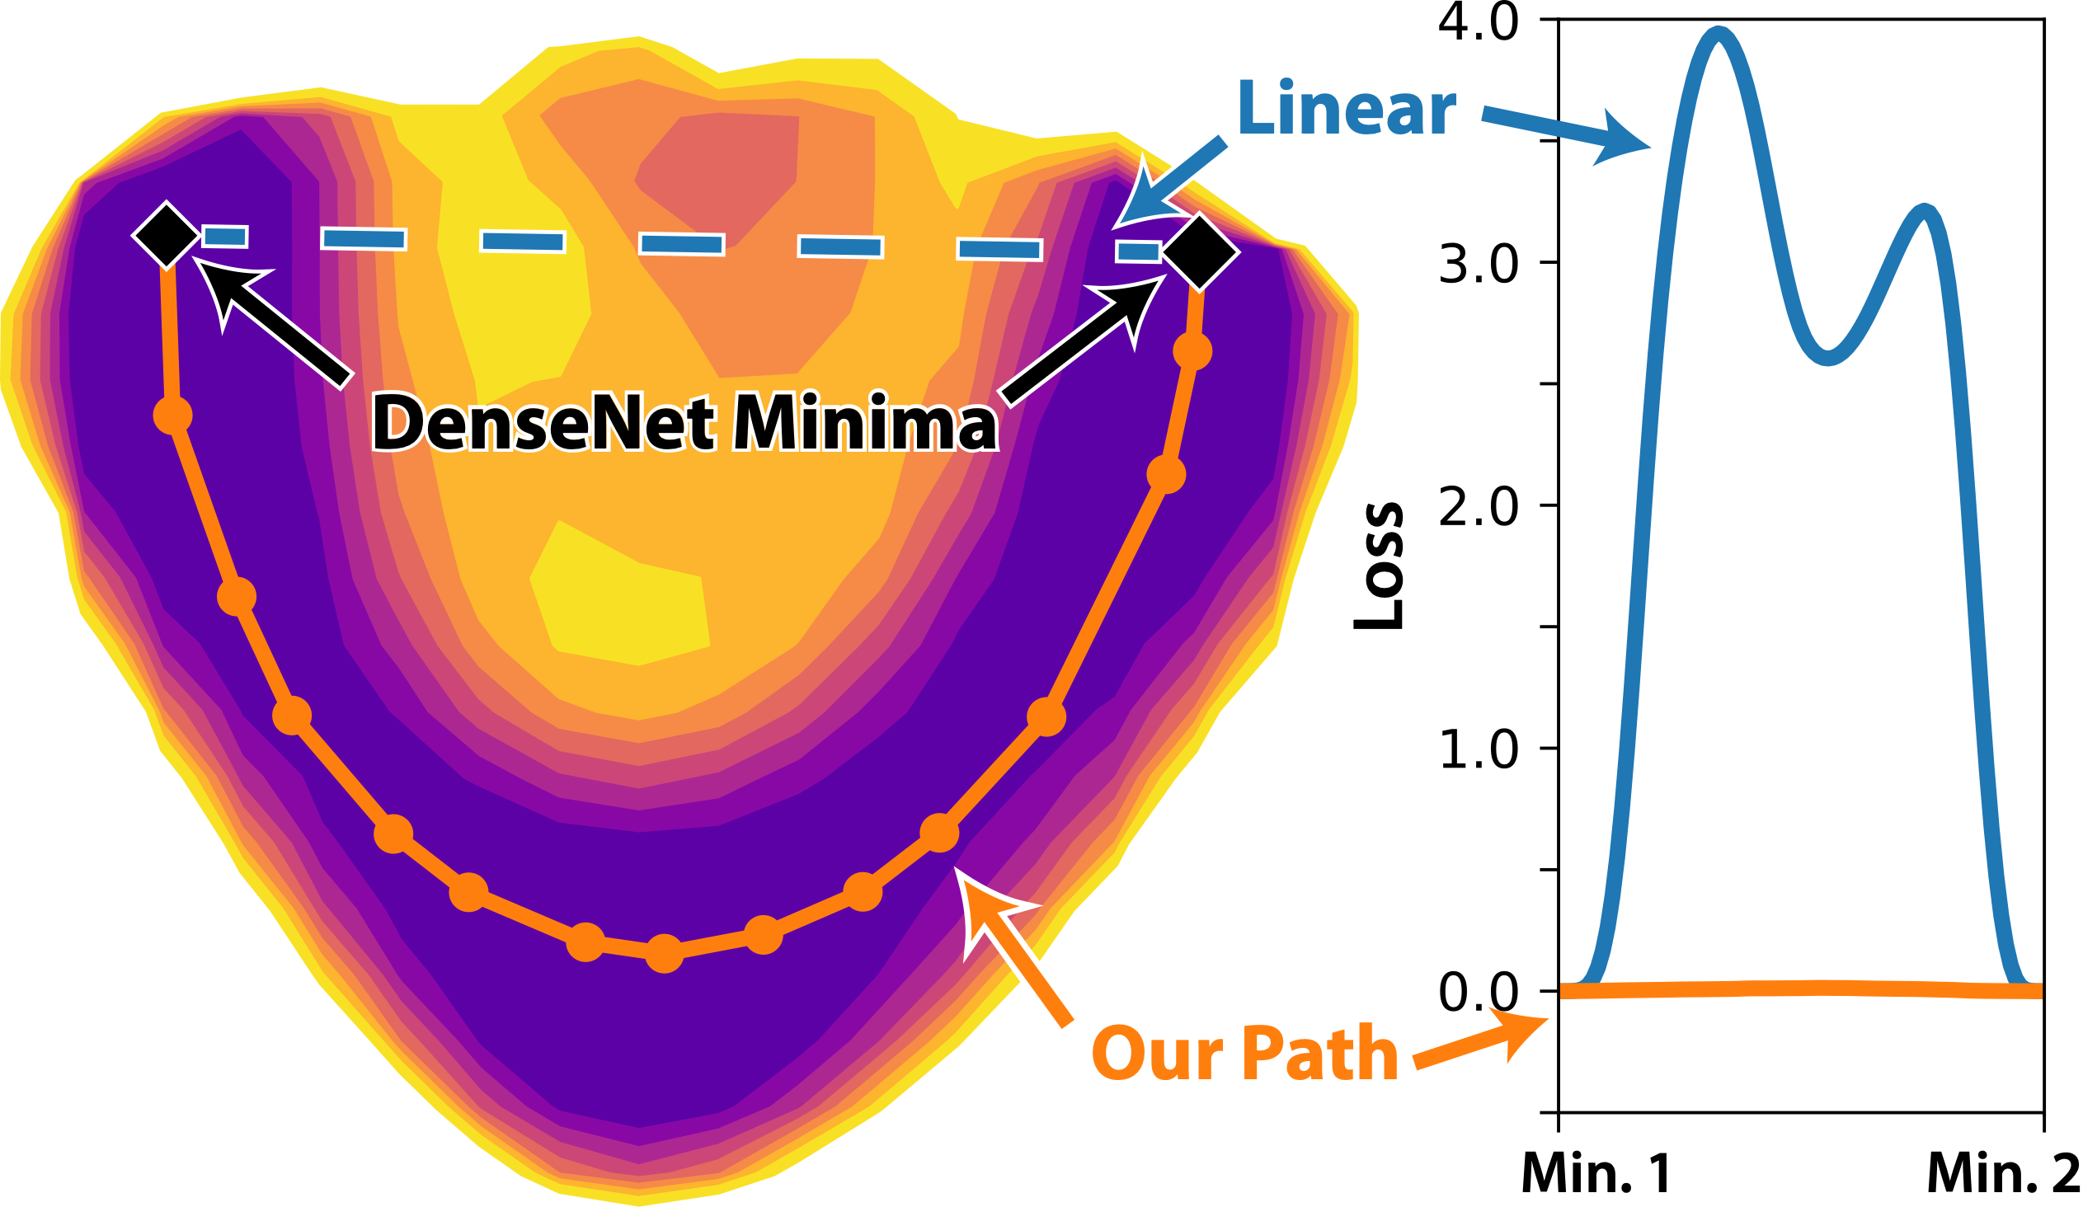
ResNet and DenseNet
Notes:
We can construct flat paths!
Most appealing result: DenseNet on CIFAR10.
Left: 2D slice through parameter space without visible barrier!
2D slice cannot capture the full path, this is a special case.
Right: Loss along linear path and along our path. Our path is two magnitudes lower!

Slide 14
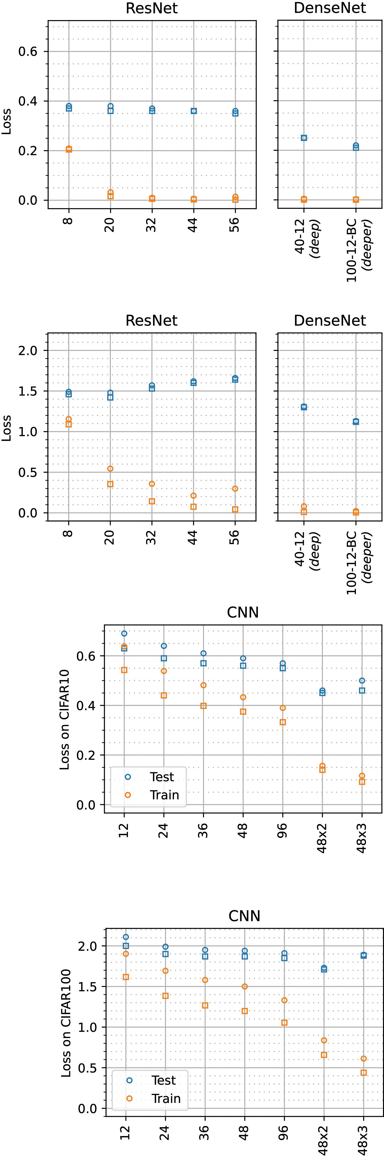
ResNet and DenseNet
CIFAR10: No barriers
CIFAR100: Very low barriers
Barriers
Minima
Test
Train
Depth
Depth
Notes:
Full results on CIFAR10 and CIFAR100.
Left: CIFAR10: No barriers. Squares are only marginally lower than circles.
Right: CIFAR100: Very low barriers. Barriers close to training minima, a magnitude below the loss of randomly initialised network.
We did our job: Ten independently trained minima and pairwise connections (error bars within points).

Slide 15
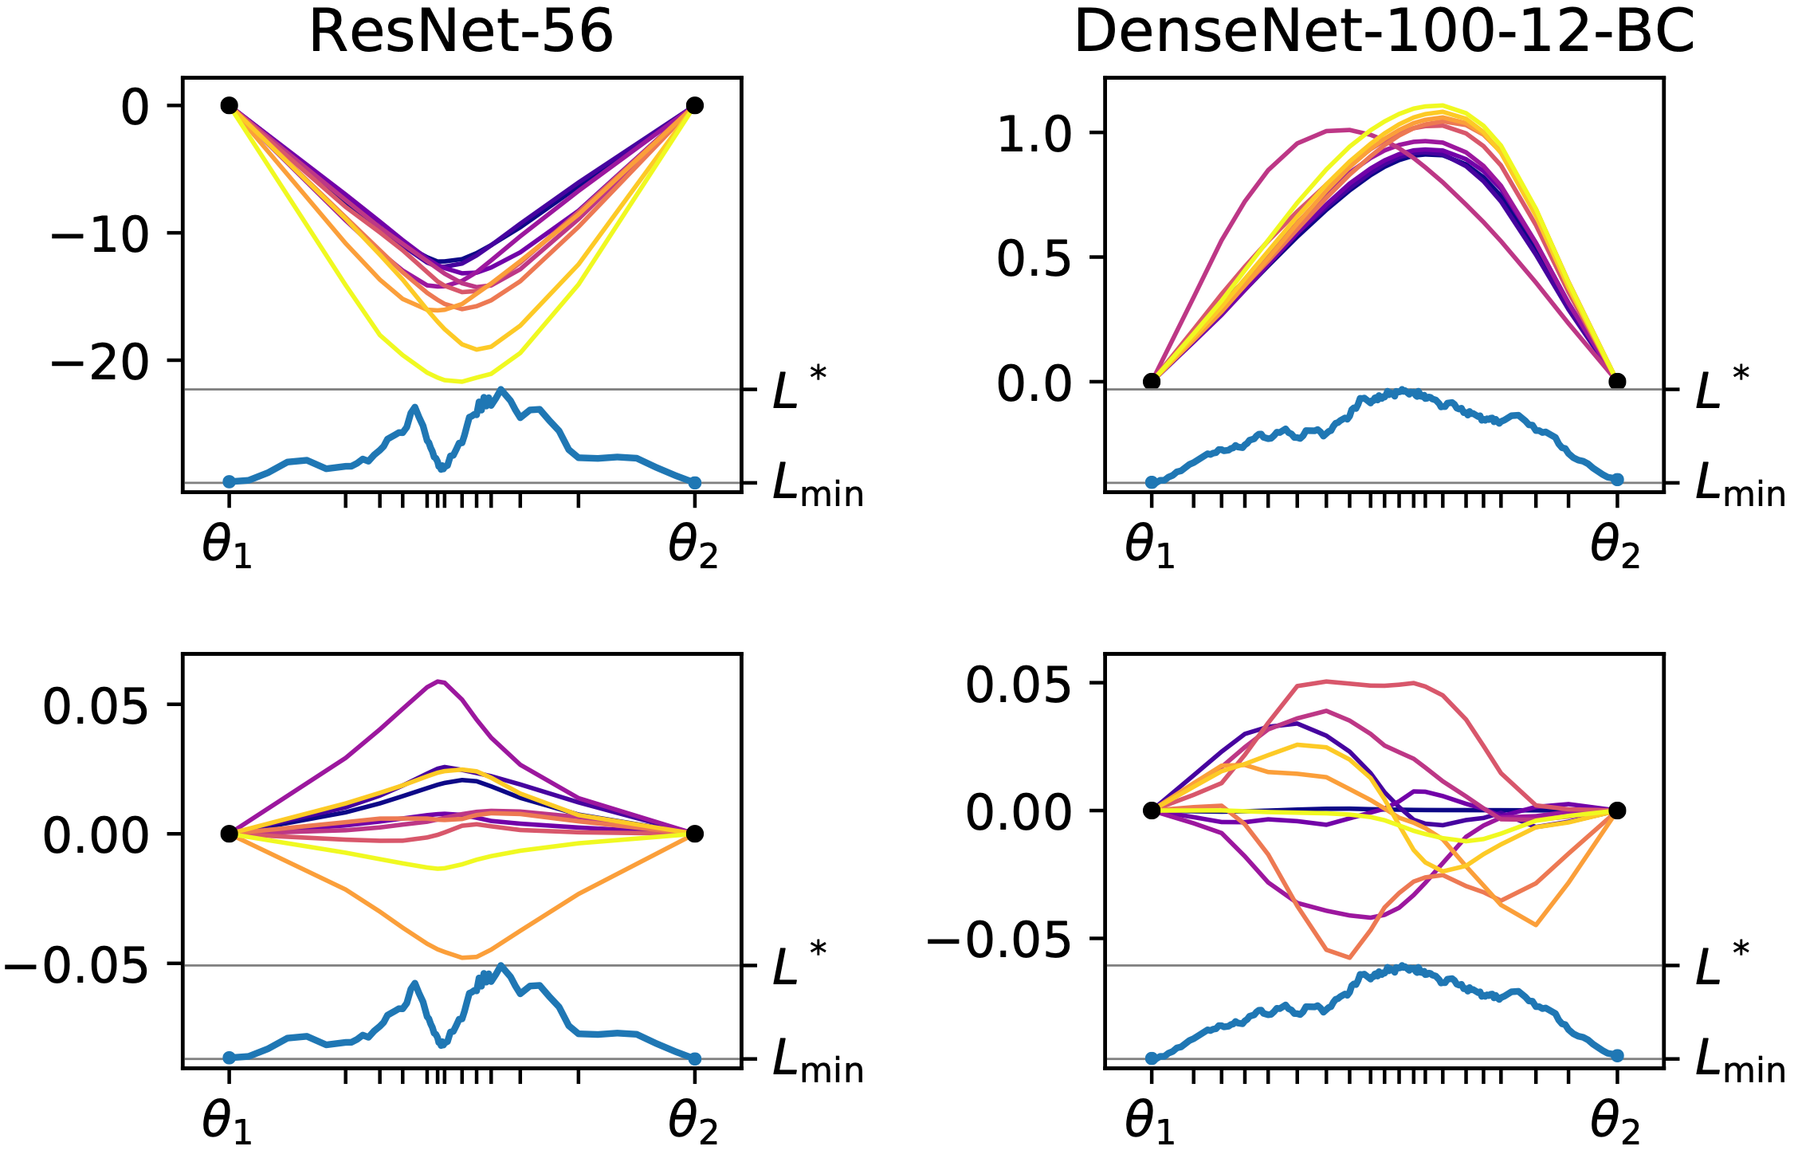
Smooth Paths
Peaked distance:
Most deviating coordinates
Deviation from linear
Smooth trajectories:
Randomly chosen coordinates
Notes:
The paths are geometrically simple:
Coordinates show:
Coordinates w/ largest distance form linear path: Peaked structure.
Random: Smooth transition.
The lengths vary between 1.8 to 3 times the length linear path.
All this is very surprising: Hints had existed for low paths, but we found simple, almost barrier-free paths!

Slide 16
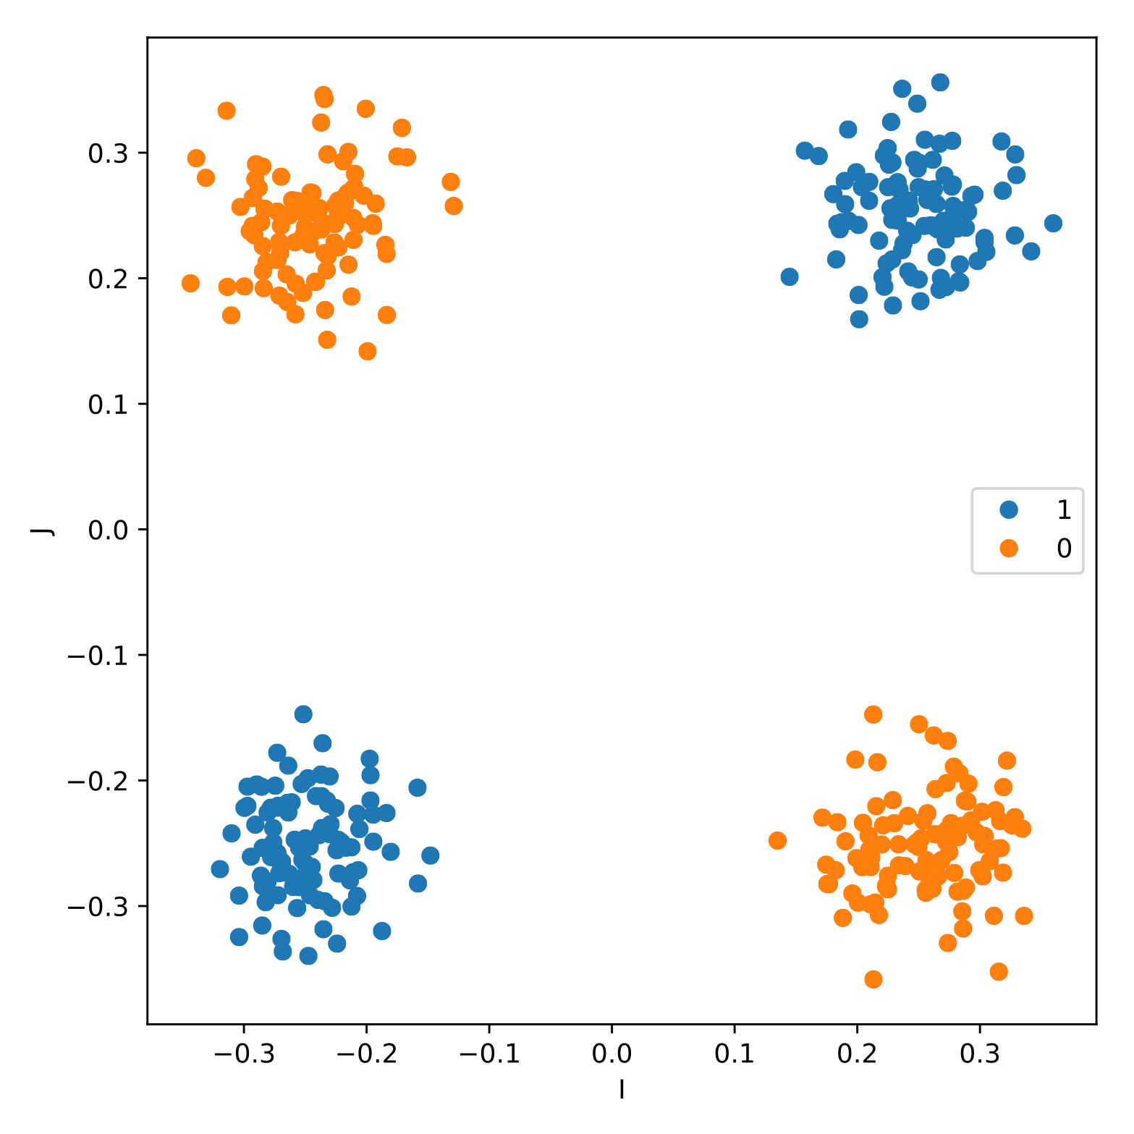
Redundancy
XOR textbook sample
Alice
Bob
Notes:
Textbook XOR data with one possible solution

Slide 17
Redundancy
XOR textbook sample
Alice
Bob
Notes:
Transition from one minimum to another not possible without misclassification

Slide 18
Redundancy
XOR textbook sample
Alice
Charlie
Bob
Notes:
Adding one more neuron to the hidden layer makes the transition possible (wider)
The same is true if you add one more 2-neuron layer (deeper)
Not trivial

Slide 19
Width and Depth
Parametric architecture: Width and Depth
Wider and deeper: Lower barriers
Barriers
Minima
Test
Train
Width
1 2
Depth
Notes:
Confirmation of wider + deeper hypothesis:
Fixed architecture with depth and width as tuning parameter.
deeper + wider = lower barriers!

Slide 20

Resilience
Perturbation
Minimum
Notes:
Sheer number of parameters makes individual parameters unneeded.
Imagine perturbing the value of one single parameter from a minimum. Loss will rise slightly.

Slide 21
Resilience
Minimisation
Perturbation
Minimum
Notes:
Keep this perturbed parameter fixed,
Re-optimise remaining parameters.
Since one single parameter is not needed, we can find a new point with the same low loss as before.

Slide 22
Resilience
Minimisation
Perturbation
Perturbation
Minimum
Notes:
Perturb again with another parameter

Slide 23
Resilience
Minimisation
Perturbation
Minimisation
Perturbation
Minimum
Notes:
Optimise again.

Slide 24
Resilience
Minimisation
Perturbation
Minimisation
Perturbation
Another
Minimum
Minimum
Notes:
-> Found a new minimum in measurable distance.
Sheer number of parameters makes individual parameters unneeded.
No experimental backup of this procedure, but our results show that this stuff exists!

Slide 25
Final Thoughts
Connected minima inspired Fast Geometric Ensembling (Garipov et al., NIPS 2017)
No energy scale to compare barrier
↗ Mode Connectivity

Slide 26

Essentially No Barriers in Neural Network Energy Landcape
Contributions:
AutoNEB: New method for landscape analysis
Loss surface of deep NNs: Very low barriers
Minima form one single connected component of low loss
Outlook:
Characterise loss landscape further (e.g. Wales et al., ’98)
Connected minima inspired Fast Geometric Ensembling (Garipov et al., ’18)
Code available at:
github.com/fdraxler/PyTorch-AutoNEB

Slide 28
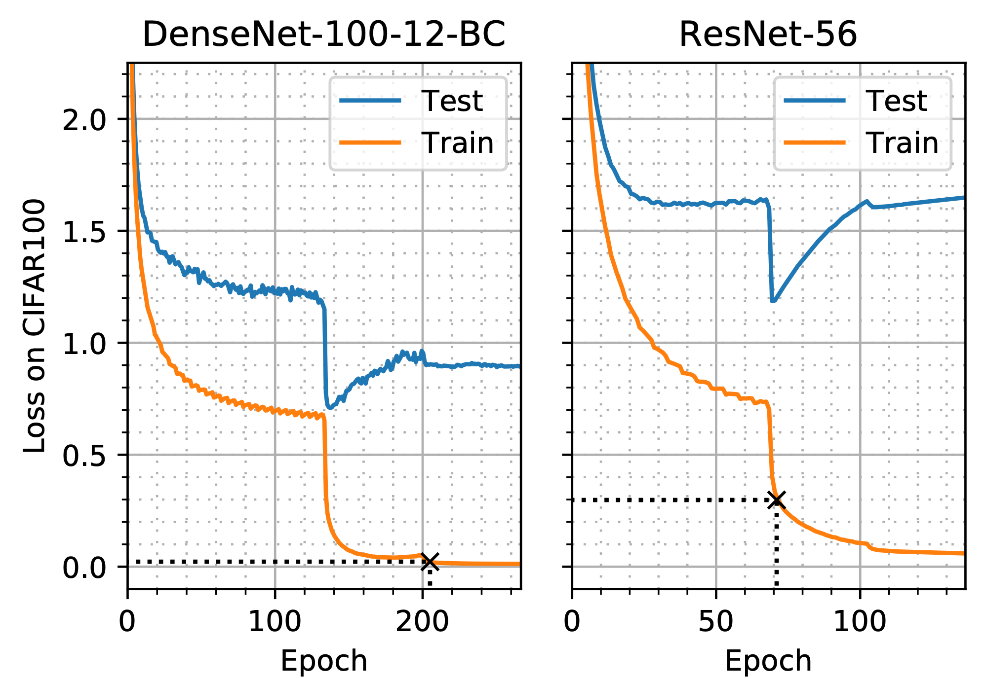
Connectivity Measures
Loss
Untrained Network
Barrier
Test
Minimum
Barrier
Train
Minimum
0

Slide 29
Spurious High Barriers

